Slide 1
LAQF WEBINAR
Our Procurement Strategy
for the audits of 2023/24 – 2027/28
16 February 2022

Slide 2
Agenda
13:00 | Introduction & Welcome | Steve Freer Chair, PSAA
13:05 | How have we got here? | Tony Crawley, Chief Executive, PSAA
13:15 | Our Procurement Strategy | Julie Schofield, Senior Manager, PSAA
13:30 | Q&A panel session
13:55 | Opting in to PSAA’s scheme from April 2023 | Julie Schofield Senior Manager, PSAA
14:00 | Closing comments | Steve Freer

Slide 3
How have we got here?
2017 – steady state; PSAA procures audits for 98% of LG bodies from 2018/19
2018 – a very significant turning point for the whole audit industry
2020 – over 170 recommendations emerge from four Government reviews, alongside very visible signs that local audit is under stress
a significant number of audit opinions not given by the publishing date
  2019/20 = 264 (55%) of which 56 (12%) are outstanding today
a shortage of audit staff with the requisite skills and experience
more demanding regulatory requirements which increase the time and effort needed for an audit
local bodies entering more frequently into innovative transactions and capacity shortages in finance and other staff to deal with the volume and complexity of local government accounts
the challenges posed by the pandemic for all parties including its implications for auditors’ work eg on their risk assessment and financial resilience

Slide 4
How have we got here?
2021 – another very turbulent year….
Government’s responses to the Redmond review
NAO’s timeliness report
PAC hearing, resulting report and recommendations and follow-up
Establishment of the Local Audit Liaison Committee (public minutes)
DLUHC’s Local Audit Framework Technical consultation
Appointing Person regulations changes in relation to fee setting
New Code of Audit Practice implemented – VFM arrangements commentary
Vast majority of 2020/21 audit opinions delayed (only 9% by 30/9) and still only at 43%
It is clear that there are no quick fixes or easy solutions which we or other parties can simply take so returning to a more predictable and stable position will take some time and be gradual

Slide 5
Timeliness – package of measures
DLUHC Timeliness package of measures – 16-Dec-21
£15m per year for three years for audit fees
audit deadline 30-Nov for 2021/22, then 30-Sep
new routes to become a Key Audit Partner
new local audit diploma and technical advisory service
more guidance for audit committees (potentially statutory)
project to review 2022/23 accounts
potential time-limited changes to 2021/22 accounts Code (Emergency proposals issued 3 Feb, responses by 3 March)
procurement geared to current challenges
industry led workforce strategy

Slide 6
Procurement Strategy
Work specification is set by others
Local Audit and Accountability Act 2014
The Accounts and Audit Regulations 2015
Code of Audit Practice and Auditor Guidance Notes
  currently set by the NAO
  DLUHC proposal to transfer responsibility to the system leader, namely ARGA, the new regulator being established to replace the FRC
FRC and ICAEW as professional regulators – PSAA has no role in the registration of auditors or in audit quality inspections – a deliberate feature of the local audit system
Unique features of local audits
  Value for money arrangements commentary
  Elector objections and other information from the public
  Statutory reporting arrangements
Code of Audit Practice compliant audits for eligible bodies:

Slide 7
Procurement strategy
Aim and objectives
Aim: to secure the delivery of an audit service of the required quality for every opted-in body at a realistic market price and to support the drive towards a long term competitive and more sustainable market for local public audit services.
Objectives are to maximise value for local public bodies by:
securing the delivery of independent audit services of the required quality;
awarding long term contracts to a sufficient number of firms to enable the deployment of an appropriately qualified auditing team to every participating body;
encouraging existing suppliers to remain active participants in local audit and creating opportunities for new suppliers to enter the market;
encouraging audit suppliers to submit prices which are realistic in the context of the current market;
enabling auditor appointments which facilitate the efficient use of audit resources;
supporting and contributing to the efforts of audited bodies and auditors to improve the timeliness of audit opinion delivery; and
establishing arrangements that are able to evolve in response to changes to the local audit framework.

Slide 8
Procurement strategy
Headline messages
Procurement strategy published on 22 September 2021 – revised version published 1 February 2022 to reflect changes to the appointing person regulations, our lotting structure and bidding rules
We have two procurements running in parallel (launched on 7 February)
  Main procurement of audit services for opted-in bodies for 2023/24 to 2027/28
  To establish a DPS (dynamic purchasing system) for audit services for opted-in bodies (operational during May 2022)
Our approach to the Main procurement seeks to reflect your consultation feedback and the challenging market conditions
We have engaged extensively with the market, recognising we are wholly dependent on them – we need to retain existing suppliers and attract new ones
We believe we have done all we that can to support a successful outcome, it now rests with the market to respond positively

Slide 9
Procurement strategy
Main procurement: key characteristics
Restricted procedure under public contract regulations 2015
Contract length: 5 years with option to extend by up to 2 years by mutual agreement
Bids permitted from consortia or other forms of joint working
Selection questionnaire stage evaluation = pass or fail
  will assess information assurance arrangements, in addition to the usual checks
Basis for bid pricing will be the ABNV associated with that lot
  ABNV will be 2021/22 scale fees plus actual and estimated recurring fee variations since 2021/22 fees were set
Both price and quality will be scored using the inverse proportionality method
Variant bids will not be permitted

Slide 10
Procurement strategy
Contract lots
based on of 2021/22 scale fees plus
(assuming same 98% of eligible bodies opt in)
Lot | Approximate percentage of the overall work | INDICATIVE VALUE ONE YEAR | INDICATIVE VALUE FIVE-YEAR
1 | 18% | £ 5,940,000 | £ 29,700,000
2 | 16% | £ 5,280,000 | £ 26,400,000
3 | 14% | £ 4,620,000 | £ 23,100,000
4 | 12% | £ 3,960,000 | £ 19,800,000
5 | 8% | £ 2,640,000 | £ 13,200,000
6 | 7% | £ 2,310,000 | £ 11,550,000
7 | 6% | £ 1,980,000 | £ 9,900,000
8 | 5% | £ 1,650,000 | £ 8,250,000
9 | 5% | £ 1,650,000 | £ 8,250,000
10 | 4% | £ 1,320,000 | £ 6,600,000
11 (development lot) | 2.25% | £ 742,500 | £ 3,712,500
12 (development lot) | 2.25% | £ 742,500 | £ 3,712,500
13 (development lot) | 0.5% | £ 165,000 | £ 825,000

Slide 11
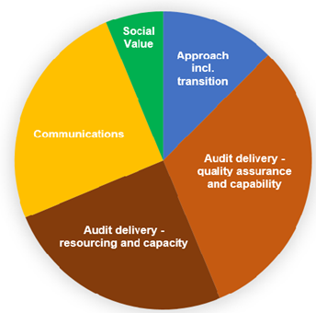
Procurement strategy
Responding to the opted-in bodies’ views: Quality
Approach incl. transition between audit firms
Audit delivery – quality assurance and capability
Audit delivery – resourcing and capacity
Communication
Social value
we have worked with the FRC on the quality evaluation questions
Lot-specific answers will apply where appropriate, e.g. resourcing, social value
suppliers will indicate their appetite/capacity for work in their ITT response
responses to resourcing questions will include an assessment of realism to deliver and how they intend to ensure their audit teams have appropriate skills and knowledge
responses will be translated into contractual obligations

Slide 12
Procurement strategy
Responding to your views: Contract management (1)
Milestone-based payment mechanism linked to audit delivery:
  production of the previous year’s Auditor’s Annual Report unless 1st year as new auditor
  production of the draft Audit Plan to Audited Body, will set out the auditor’s plan & timetable
  planned hours (50% complete)
  planned hours (75% complete)
Quarterly contract management meetings to review supplier performance to identify and agree any changes or improvements to the Services
Statement of responsibilities of auditors and audited bodies included in the Terms of Appointment
  we will communicate expectations as part of 2023/24 auditor appointment and fee setting consultations
Once appointed, auditors are independent by design of the framework

Slide 13
Procurement strategy
Responding to your views: Contract management (2)
Review Procedure to enable and manage change to the method statements provided as part of tender response (the how, not the what), for example to align with changes in industry good practice or audit requirements
Rectification Plan Process in the event of a Notifiable Default
Annual Quality Review Report process
  FRC and associated reports
  Satisfaction survey with opted-in bodies
  Compliance with Terms of Appointment incl. any complaints
  Reports published on our website and shared with our Advisory Panel

Slide 14
Procurement strategy
Responding to the market’s views
Tender evaluation quality/price ratio of 80:20
Acknowledged firms may have geographical areas which are least attractive to audit
Increased lots – greater choice and more flexibility to match capacity / risk appetite
Contract extension by mutual agreement (rather our sole discretion)
Expanded time period for tenderers to produce their responses
Provide detailed information on what is included in the scale fee of every audit
Fee variation rates determined by a tenderer’s bid rate against our published rate card
Annual application of inflation from year 2, at the CPI 12-month rate most recently published before each April
Published a risk allocation matrix, designed to support consideration of the key contract risk areas to inform bidding
Encouraging new entrants: will accept tenders from firms currently proceeding through the registration process, but must be accredited by 13 Sept to be awarded a contract
Parallel procurement to establish a DPS – reduced risk of supplier “lock out”
Unlike other parts of the UK, we are totally reliant on the market to provide external audit services

Slide 15
Indicative timescales
Activity | Target date
Contract Notice published, procurement documentation including contract terms made available on Delta e-tendering platform – also Contract Notice published for DPS | 7 February 2022
Deadline for eligible bodies to submit their opt-in acceptance | 11 March 2022
Deadline for submission of completed SQ through Delta (SQ return date) and for applications to ICAEW to become a local auditor Earliest date for SQ submission for DPS (same form of response as main procurement) | Noon, 18 March 2022
Evaluation of selection questionnaire responses and PSAA Board to confirm shortlist to be invited to tender and also suppliers to be appointed to the DPS (a 10-day standstill period will follow) | 19 March to 4 April 2022
Invitation to tender issued to shortlisted Potential Suppliers, via Delta | Noon, 7 April 2022
DPS will become operational for use as and when required | May 2022
Deadline for Tenderers to confirm their intention to submit a Tender Response | 4 July 2022
Deadline for submission of completed invitations to tender through Delta (tender return date) | Noon, 11 July 2022
Tender evaluation | 12 to 22 July 2022
Contract award decision made by PSAA Board | 4 August 2022
Standstill period | 5 – 16 August 2022
Contract award | late August 2022

Slide 16
Q & A

Slide 17
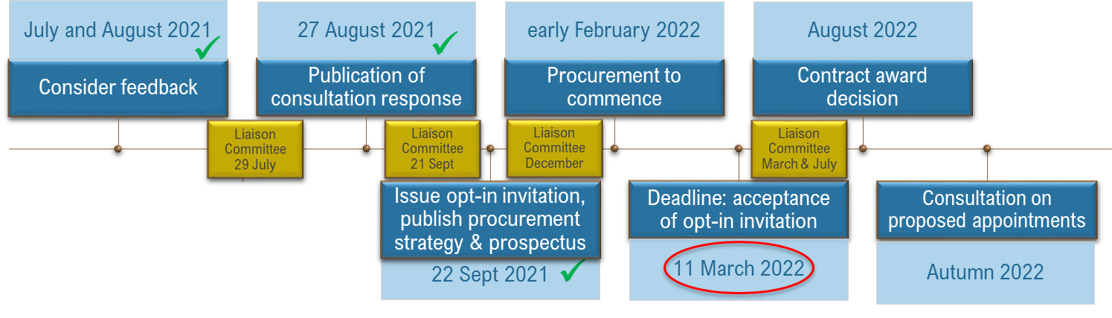
PSAA’s scheme from April 2023
Opt-in process and procurement update
✓
Your options: to make local arrangements or join our scheme
To join our scheme a decision is required by Full Council, or equivalent, the completed “form of acceptance” must be returned by 11 March 2022
We confirm receipt of acceptance, then seek information to support auditor appointment
Currently 247 opted-in bodies, with a further 146 expected pending Full Council approval
Post-procurement, we will consult you on a proposed auditor (October 2022)

Slide 18
Final webinar in this series…
Book using the link below…
16 March 1-2pm
  Understanding our contract management arrangements
Previous webinar slides available at …
  https://www.psaa.co.uk/about-us/appointing-person-information/appointing-period-2023-24-2027-28/autumn-and-winter-webinars/
  Understanding new local audit system
  Making auditor appointments
  Audit fees and fee variations

Slide 19
Information about our scheme
www.psaa.co.uk or email us at ap2@psaa.co.uk
list of opted-in bodies from 2023/24 (so far)

Slide 20
Closing comments
We value your feedback, so ask you to complete a short feedback form

