Slide 1
LAQF WEBINAR
Local Audit and Reporting Backlog Consultations:
a further opportunity to air your thoughts and seek clarification
28 February 2024

Slide 2
Agenda
11:30 | Introduction & Welcome | Steve Freer, Chair, PSAA
11:40 | Q&A panel session ‘Reset’ phase ‘Recovery’ phase | Siobhan Jones, Director, DLUHC Neil Harris, Director of Local Audit, FRC Mike Newbury, Director, NAO Tony Crawley, Chief Executive, PSAA
12:55 | Closing comments | Steve Freer
13:00 | Close

Slide 3
What is the plan for reset?
The Department has worked collaboratively with the FRC, as incoming shadow system leader, and the other key organisations, to develop these proposals, as set out in the Joint Statement.
DLUHC is seeking views on changes to the Accounts and Audit Regulations 2015 to introduce backstop dates for the publication of audited accounts. Consultation runs to 7 March.
Phase 1:
Reset involves amendments to the Accounts and Audit Regulations, and changes to the Code of Audit Practice, clearing the backlog of historical audit opinions up to and including financial year 2022/23 by 30 September 2024.
This reflects the need to ensure sufficient time for auditors to issue opinions, including modified or disclaimed opinions due to the backstop, and for bodies to publish accounts containing those audit opinions once the legislation has come into force.
FRC will also suspend annual Audit Quality Reviews (AQRs) for historic years to 2022/23 unless there are exceptional cases in the public interest. Routine AQR inspections to resume for 2023/24 audits against the NAO Code. ICAEW have agreed to mirror this with their Quality Assurance Department reviews

Slide 4
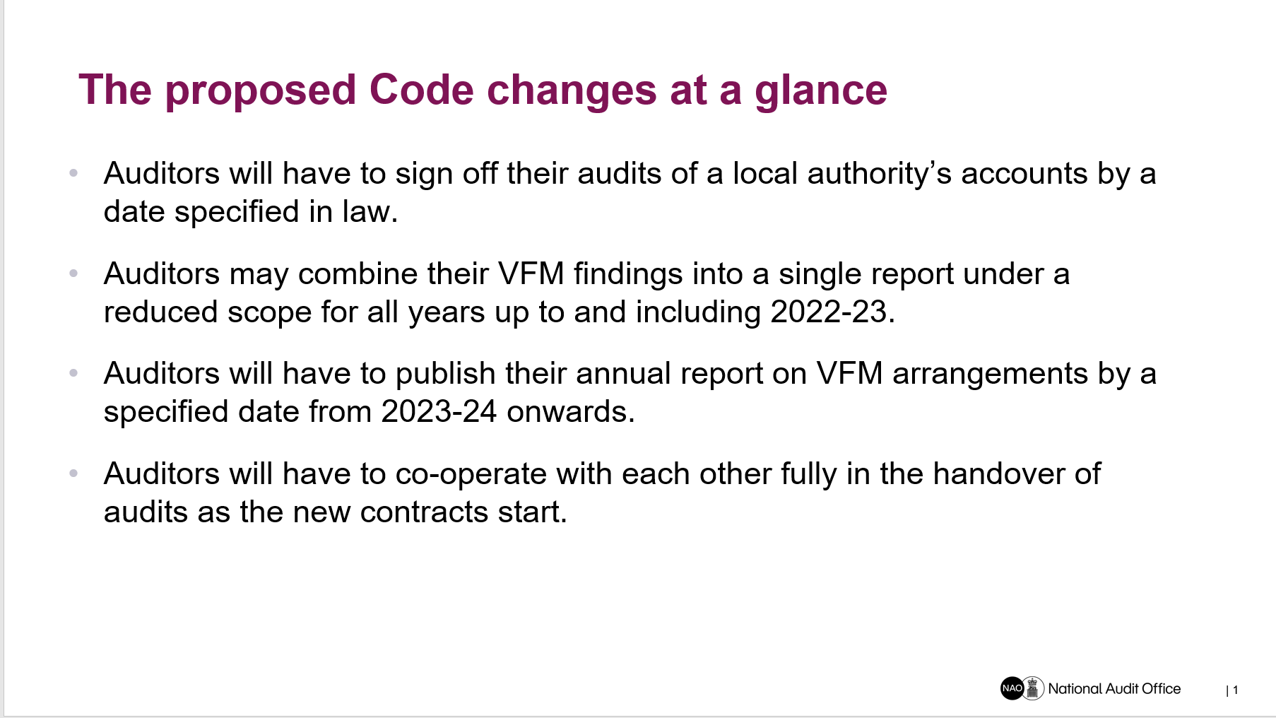

Slide 5

Financial Reporting Council
Commitments
    Within the Joint Statement, the FRC has committed to:
    Use our Technical Advisory Group and Sandbox to identify and develop guidance notes for auditors to support implementation of the reset and recovery phases in an ISA (UK) compliant manner.
    Remind auditors of their responsibilities to communicate the reasons for a modified or disclaimed opinion, including where caused by the backstop dates, and help users of accounts understand the different types of opinions given.
    Suspend annual Audit Quality Reviews (AQRs) for historic years to 2022/23 unless there are exceptional cases in the public interest. Routine AQR inspections to resume for 2023/24 audits against the NAO Code. ICAEW have agreed to mirror this with their Quality Assurance Department reviews.
    Use supervisory role to engage with audit firm leaders where there are pervasive concerns, and lead on developing an escalated reporting framework to capture and address system risks.
    The FRC hosted a series of roundtables to support the consultations being launched by system partners giving an opportunity to ask questions to help inform final written responses and provide initial feedback.

Slide 6
Q&A panel session
“Reset” phase

Slide 7
What is the plan for Recovery?
Phase 2: Recovery from Phase 1 in a way that does not cause a recurrence of the backlog by using backstop dates to allow assurance to be rebuilt over multiple audit cycles:
Year ending 31 March 2024: 31 May 2025
Year ending 31 March 2025: 31 March 2026
Year ending 31 March 2026: 31 January 2027
Year ending 31 March 2027: 30 November 2027
Year ending 31 March 2028: 30 November 2028
These dates are intended to achieve a balance between restoring timely audit and returning to unmodified audit opinions over time. They have also been designed, to the extent possible, to limit the impact on other public sector audits, including NHS audits.
It is proposed that the Code of Audit Practice will set a requirement that from 2023/24 the Auditors’ Annual Report will be issued in draft to those charged with governance by 30 November each year, irrespective of the position on the audit, to enable auditors to report regularly on most of the VFM arrangements work in a more timely and predictable way.

Slide 8
Q&A panel session
“Recovery” phase

Slide 9
Closing comments
We value your feedback on this session, so ask you to complete a short feedback form

