Slide 1
The Local Audit Office and rebuilding assurance
PSAA Webinar
28 September 2026
Notes:
---
This presentation explores how Microsoft Copilot integrates with PowerPoint to transform presentation creation through intelligent AI assistance. We will cover its features, content generation capabilities, design enhancements, collaborative tools, and best practice tips to maximise productivity and creativity.

Slide 2
Local Audit Office (LAO) – overview and progress update
LAO Chair: Bill Butler

Slide 3
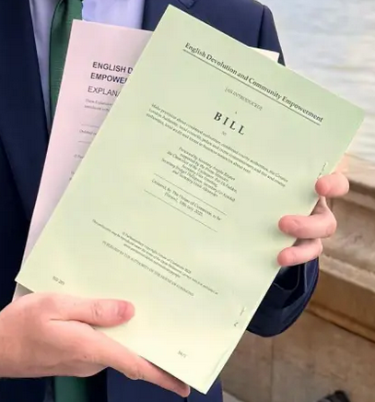
The English Devolution and Community Empowerment Act 2026 establishes the LAO and paves way for further reforms
Establishment of Local Audit Office
Code of Audit Practice
Auditor Appointments
Potential for public provision
Funding and audit fees
Quality oversight of local audit
Audit committees
Tailored audit regimes
Pension decoupling

Slide 4
The new Local Audit Office
Getting ready for launch later this autumn, before taking on all functions from April 2027
People
Leadership: Bill Butler appointed Chair, with recruitment under way for Non-Executive Directors, the Controller and Day-1 roles.
Initial resourcing: Secondments are now being advertised, with opportunities to be shared by the LGA with local authorities.
Future workforce: Wider recruitment will welcome and attract talent from across the system.
Processes
Establishment: The LAO has been established as a legal entity, with its services mapped into organisational design.
Preparing: Work is ongoing to put the essential systems, functions and structures in place for launch.
Activating: Commencement regulations to ‘switch on’ relevant functions for the Local Audit Office are in progress.
Reach out to LocalAuditOfficeRecruitment@Communities.gov.uk to express an interest in working for the LAO and share with your networks

Slide 5
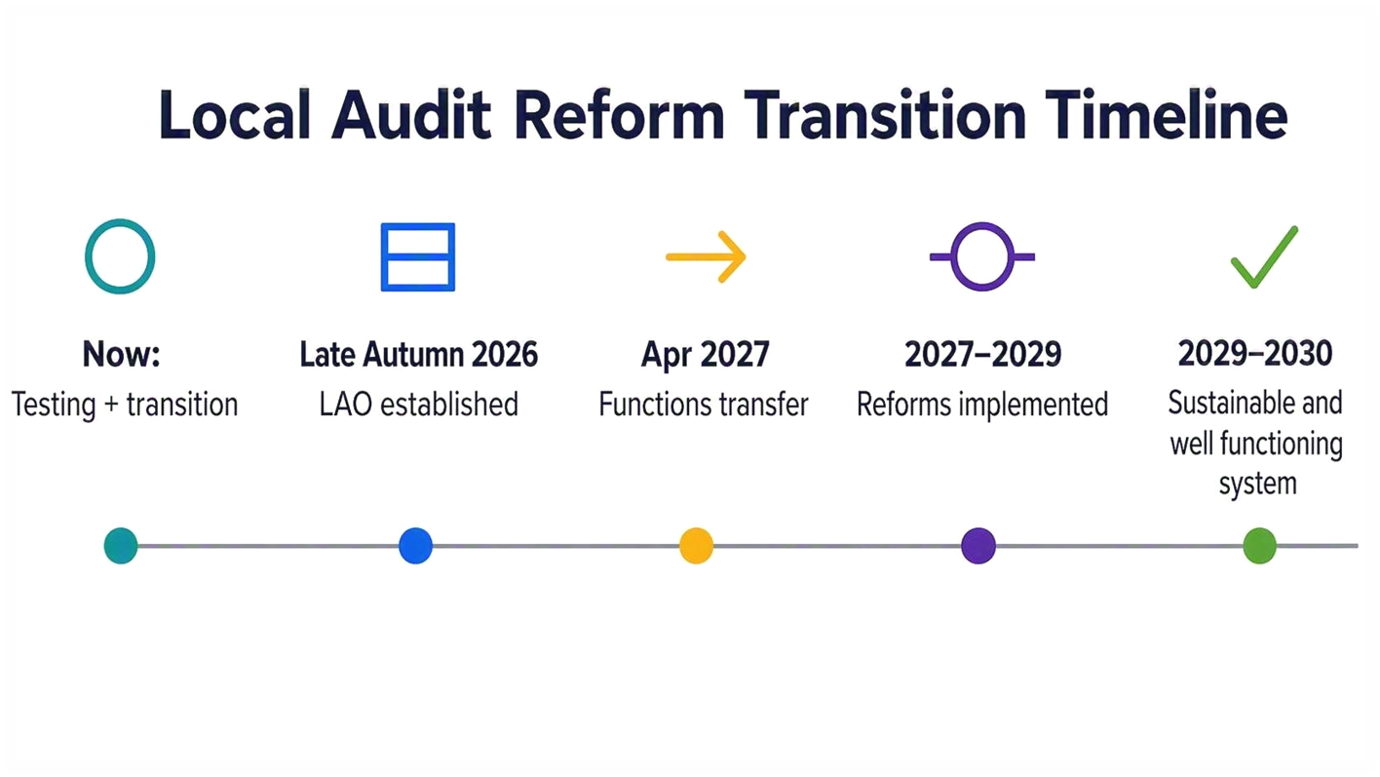
Transition to a new local audit system

Slide 6
Update on work to rebuild assurance
Deputy Director: Rosie Seymour

Slide 7
Improving our understanding of progress
Details of our phase 2 analysis
Phase 1 – Analysis of Auditors’ Annual Reports (AARs) and ISA 260 reports
Analyse reports to identify system-wide challenges and improve understanding of progress
Phase 2 – Capacity assessments and revised cost estimates
Auditors’ assessment of each body’s capacity to rebuild assurance by 2027/28
Local bodies able to agree or disagreement and add comments
Aim to gain a more granular understanding of risks and constraints, and timing and cost of build-back work
Analysis of reports is substantially complete, and analysis of capacity assessments and cost estimates is ongoing.
Findings will be used to support further policy work and identify any further measures that may be needed to support progress.

Slide 8
Build-back
Wider progress
Build-back grant
Payments made to more than 200 bodies as of May 2026, with a small number of bodies yet to become eligible
Revised cost estimates will inform a review of the grant this autumn to ensure that distribution remains fair and appropriate
Further payments dependent on the review as well as progress of build-back
Quality review and improvement
  Bespoke approach to quality review of audits undergoing build-back
Training and guidance for auditors
  CIPFA training on audit readiness: 5 half-day courses in March and May with almost 500 delegates from 165 local bodies, with positive feedback
Pension decoupling
  Final round of engagement underway to finalise detailed proposals
  Work on secondary legislation and additional guidance will take place ahead of implementation for 2027/28

Slide 9
Publication of 2025/26 statement of accounts
Deputy Director: Rosie Seymour

Slide 10
2025/26 Statement of Accounts
The backstop for publication of the 2025/26 statement of accounts is 31 January 2027.
Any outstanding draft accounts must be published by 14 December 2026 for the inspection period to conclude by the backstop. Draft accounts, narrative statement and AGS must all be published before the 30-working-day inspection period begins.
Please contact MHCLG at localaudit@communities.gov.uk if you expect to be unable to meet the 2025/26 backstop.
If your body’s audit opinion is not published by January’s backstop, you must publish copies of any delay or exemption notices on your website and email MHCLG a copy of any delay notice.

Slide 11
Thank you
Questions and Discussion
Notes:
---
This presentation explores how Microsoft Copilot integrates with PowerPoint to transform presentation creation through intelligent AI assistance. We will cover its features, content generation capabilities, design enhancements, collaborative tools, and best practice tips to maximise productivity and creativity.

